Slide 1

Media Board
Courtney Lee, Jamie Hood, Mark McNiskin

Slide 2
Media Board: Who We Are
The Media Board serves as the advisory board to all campus media outlets. Our
15 member organizations produce journalistic, academic, creative, and social content for members of the Georgetown community, including students, faculty, and alumni.
Common goals:
Providing platforms for student voices
Distributing news, knowledge, and art
Fostering creativity and building media/communications skills

Slide 3
What we offer our members:
Skill Based Learning
Journalism
Ethics
Reporting
Writing
Print Layout and Design
Photography/Filmmaking
Creative Writing
Music Programming
Broadcasting
Marketing
Selling Advertisements
Budgeting for fiscal years
Students have gone on to work and intern at major organizations because of the skills they have learned here:
POLITICO
The Washington Post
The New York Times
9:30 Club
NBC
NPR

Slide 4





Engagement Highlights
NEWSPAPERS
Our news outlets report that 85-95% of copies distributed are picked up
BOSSIER: 23,200 website views/yr
CARAVEL: 25,000 website views/yr
THE HOYA: 100,000 website hits/month
THE VOICE: 11,000 website views/week
GUCCI: 1,700 followers (Facebook)
SPOON: 7,500 followers (Instagram)
THE HOYA: 16,000 followers (Twitter)
GUTV: 150 followers (YouTube)
MAGAZINES
Our journal publications report 95-100% of copies distributed are picked up

Slide 5




Growth
Several new organizations have either joined Media Board in recent semesters or are currently in the new club development process
Give specific communities on campus a platform for expression
Bossier
GUCCI
The Blaxa Media Group
Significant and lasting student involvement in new organizations

Slide 6
Financials: Big Picture
Printing and Online Services $$$
Printing contracts (reference FY19 printing table)
Adobe = $30/mo per user
Website = $150-$1800 per year
MailChimp = $1000 per year
Equipment $$
Replacing infrastructure 20+ years old
Expanding multimedia presence
Making online programs accessible for members
Events $
Concerts, galas
Collaboration w/ other student groups
NCD $
MB expansion
Building infrastructure

Slide 7
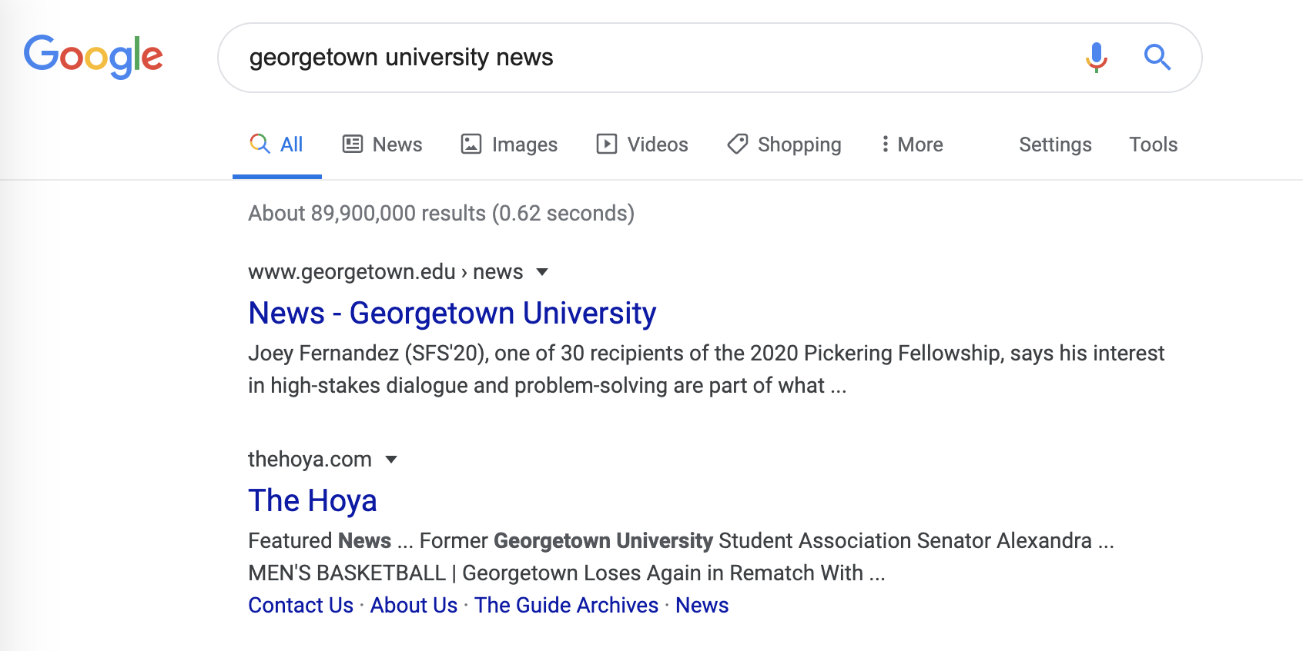
Importance of Campus Media
Campus media is the face of a university

Slide 8
Printing information for your reference
How much are we printing?
The Anthem: 350 magazines per semester
Bossier: 500 magazines per semester
The Independent: 3 issues per semester (1000 copies per issue)
The Caravel: 3 issues per semester (over 1000 copies per issue)
The Voice: 8 issues per semester (1000 copies per edition)
The Hoya: 14 issues per semester (4000 copies per issue)
Utraque Unum: 600 journals per semester

Slide 9
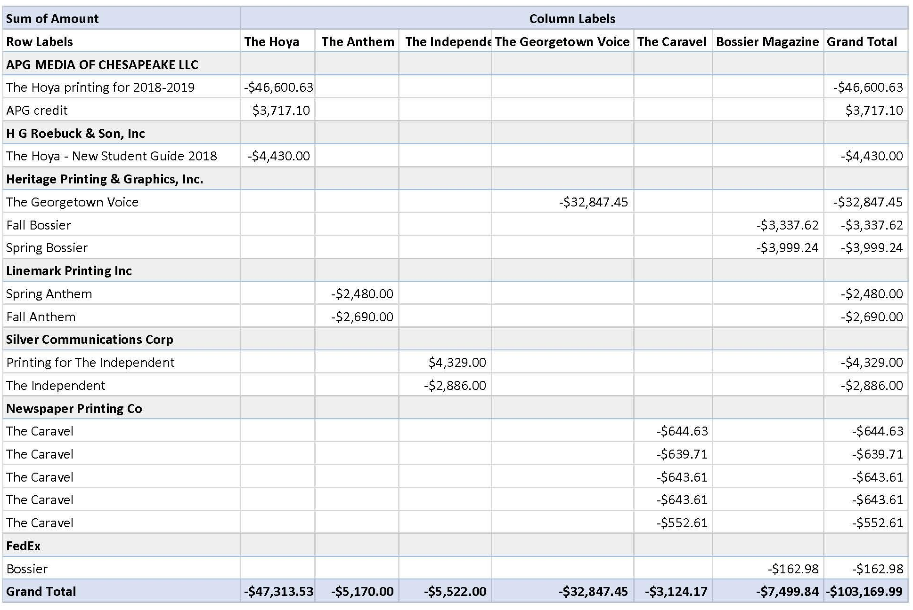
FY19 printing contracts

